Slide 1

Introductory
Meeting #1: A little bit about UoG FAS
18/10/2019

Slide 2

Some Questions That You Might Have:
Who are you?
What am I letting myself in for?
Is our cause worthy of Your time?
Do I need any experience?
What are some expected costs?
What level of training do you provide?
Who are the Organisations you’re partnered with?

Slide 3
About Us
Previously established & operational in the early 2010’s, kickstarting again as a separate entity in mid-2018.
A Former St. John Ambulance Volunteer Unit for the Region
Fundamental principal of promoting Student Welfare (First Aid awareness is one of many faces of such)
We provide a platform for our partners to deliver First Aid Training to everyone regardless of previous experience (those who want it…)
Offer a very wide-variety of opportunities for volunteering!

Slide 4
What am I Letting Myself in For?
It’s a pertinent question.
ANSWER:
Whatever YOU want!
(and a crackin’ CV)

Slide 5
Continued…
Unlike other Societies, we don’t expect or enforce a minimum amount of commitment!
Life’s busy, we’re all here for a Degree and Assignments stack-up. Plus, have you been to top floor Moos on a Wednesday?
With that being said, the more time you put in – the more you get out. The more seats we can fill, the higher-level of training we access!
Other then the £1 Student Union enforced membership fee, we don’t charge for membership!

Slide 6
And for the Necessary Experience/Knowledge?
Absolutely none!
Everyone can and should learn the minimum of life-saving techniques.
Accidents happen! Try explaining to your Parents that you broke your leg on a sun-lounger…I did!
In all seriousness, it may never happen – but if a serious medical emergency occurs; Can you help?

Slide 7
You Said Volunteering?
You’re right. I did.
We help out with a lot of events! Just for an idea…
UoG Pub Sports Help-For-Heroes Pub Crawl
Cheltenham’s 2019 Half Marathon
Student Nights in Cheltenham’s Night Time Economy
Fresher Move-In Days
University Open Days
We want to expand!

Slide 8


Volunteering Uniforms
As Volunteering is optional, and we do not have dedicated-funding (yet)
Uniforms are purchased at your expense!
But we have an extremely competitive price for them.

Slide 9
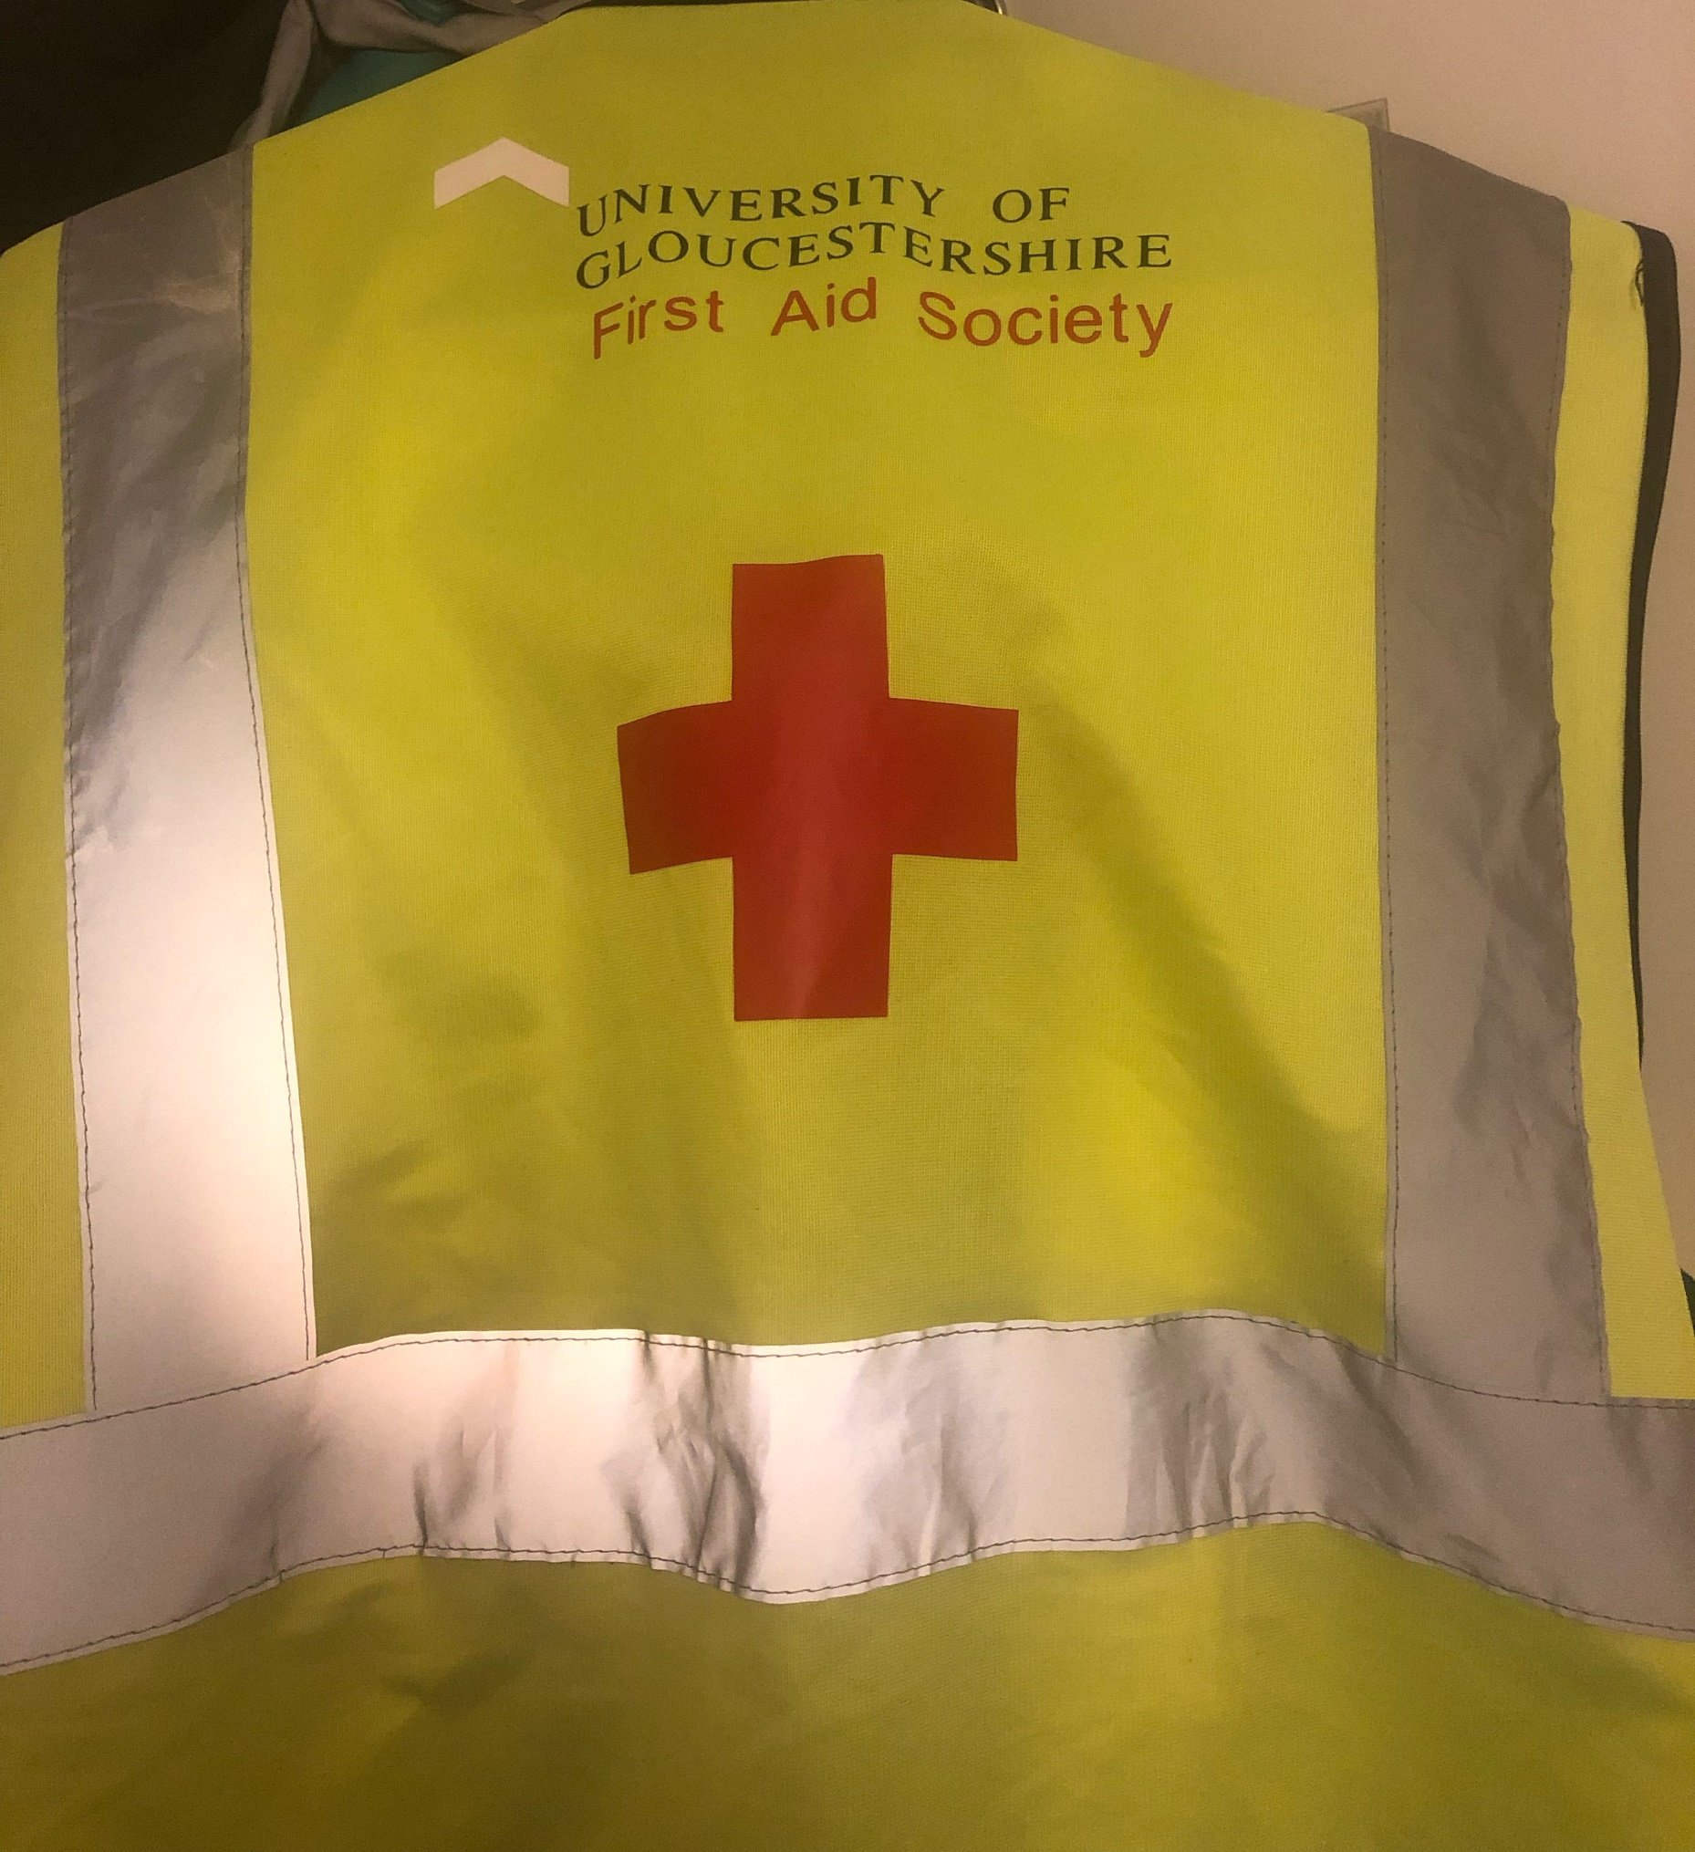
Met Gala Who?
With UoG FAS, Yellow’s not only your colour but ours too! Cute!
(And a bit of red, dabble of black and a splosh of white.)

Slide 10
No Plasters? No Problem.
When push comes to shove, essential life-saving skills can’t be packed into a Medical Bag.
Who carries around a 300-piece medical kit on the way to Lidl? No one – unless you live near a very dangerous Lidl. After all, the pastries do fly off the shelves; It’s a serious game.
In times of crisis, YOU can help.

Slide 11
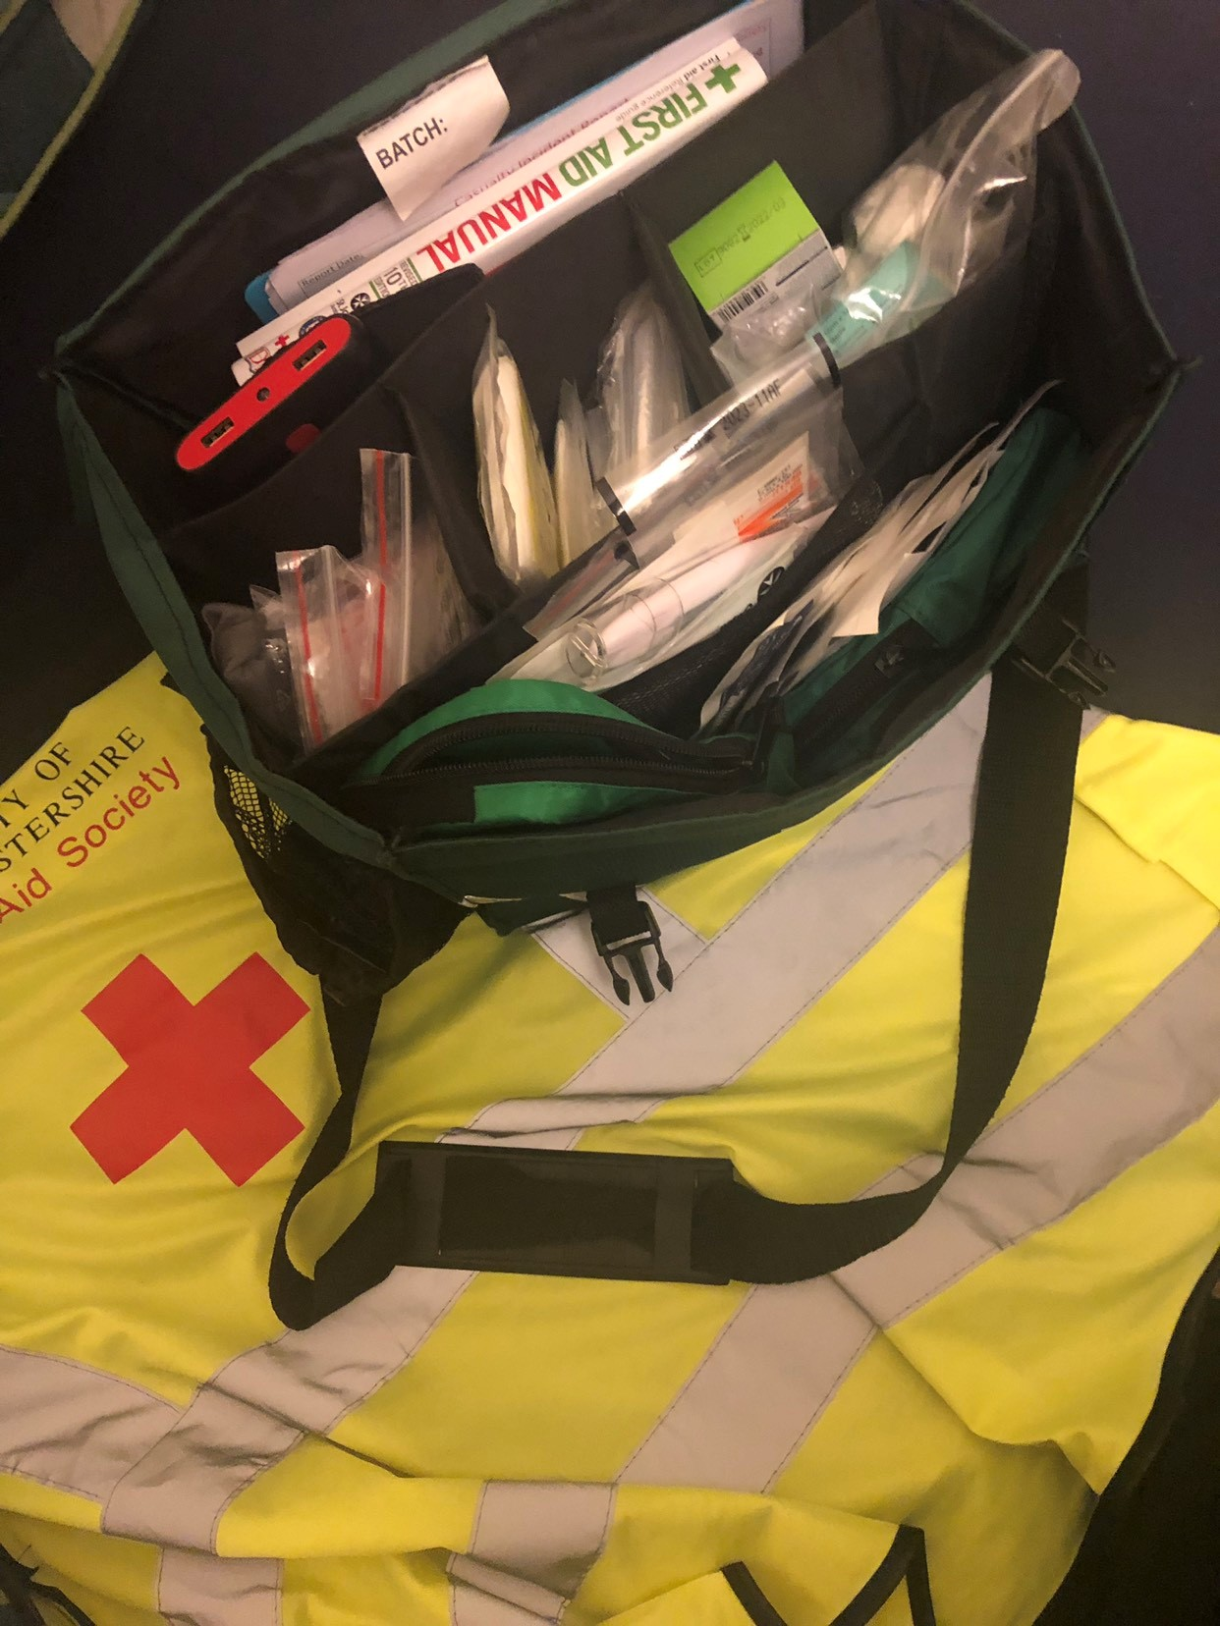
The Kit’s Kinda Important Too
UoG FAS live wild lifestyles.
Yes, you guessed right – bandage race-offs.
UoG Athletics…watch out.

Slide 12
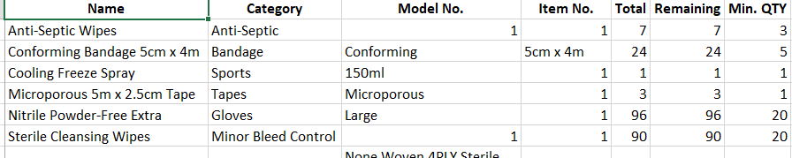
Kit Continued…

Slide 13
Who Supports Us?
Cheltenham Guardians
A quintessential team in Cheltenham’s Night Economy
Provides us with Training Awareness services
St. John Ambulance
Most of our kit-consumables is accrued through SJA
Providing platforms for formal training and certification if pursued
An excellent relationship at the leadership level with SJA for the future endeavours of the Society.
You!

Slide 14


Cheltenham Nightsafe Scheme

Slide 15
Our Prospective Roadmap for the Society:
September:
Initial recruitment drive of Members & developing the relationships with our Partners
Forming a much more concrete path on how the Society should progress and advertise itself as.
Resourcing with the local St. John Ambulance Cheltenham Unit.
October-December:
Beginning First Aid Awareness Provisioning with our Partners to both Members and accommodating non-Members (with Members given priority)
Committee / Selected Members begin unit leadership training with St. John Ambulance for pre-requisites to re-forming as a SJA Unit if desirable for the Society.

Slide 16
Continued…Our Prospective Roadmap of the Society:
January-Onwards:
Progressing the available First Aid training & volunteering opportunities within the Society to advanced levels.
Pursuing SJA ties if considered best direction for the Society & Members.
Relationships with Partners will still be continued
If continuing as an SJA LINKS Unit isn’t suitable for all parties at the current time, Society will proceed as per-norm.

Slide 17
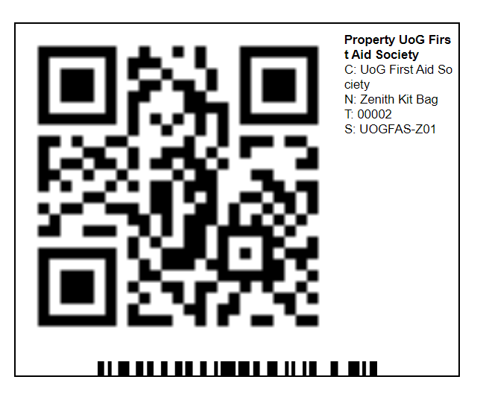
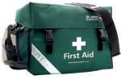
Our Technologies – Asset Management
We quickly realized that an Excel spreadsheet (or two) wouldn’t suffice for managing our equipment and medical supplies!

Slide 18
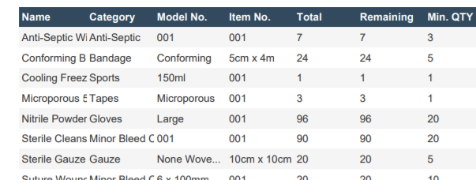
Asset Management Continued…

Slide 19
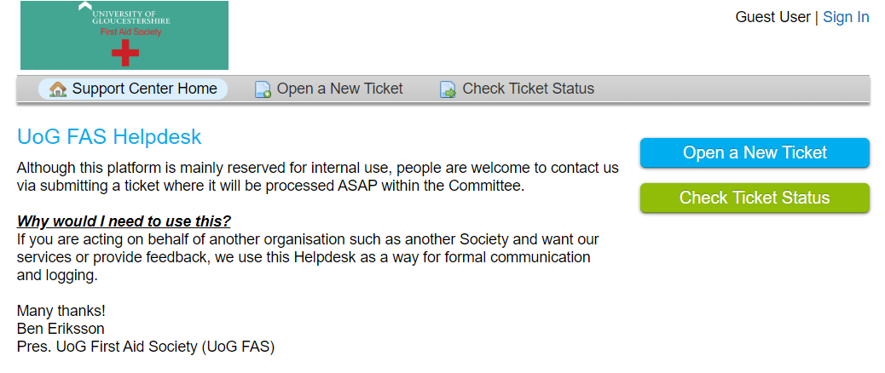
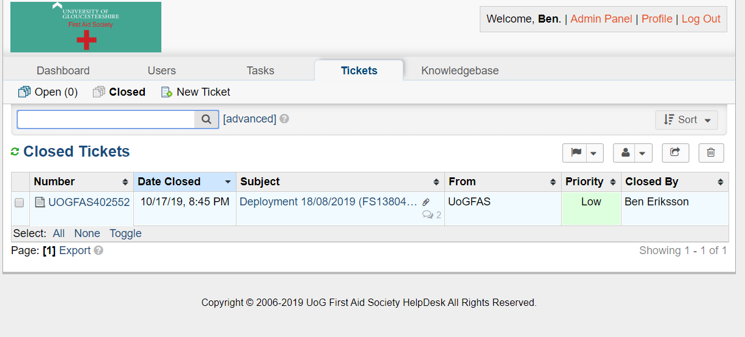
Our Technologies – Helpdesk Demonstration
https://helpdesk.uogfirstaidsociety.org.uk/
Front-End
Behind the Scenes

Slide 20
Our Technologies – Resource Sharing
Sharing is caring, and that’s especially true with the flu.
We have a simple and modern system for sharing resources such as Presentations!
All accessible from your Phone, Laptop, Fridge, etc

Slide 21
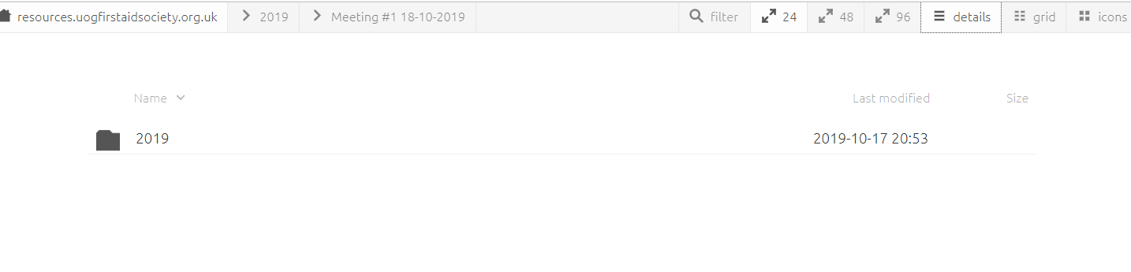
Resource Sharing Continued…
https://resources.uogfirstaidsociety.org.uk/

Slide 22
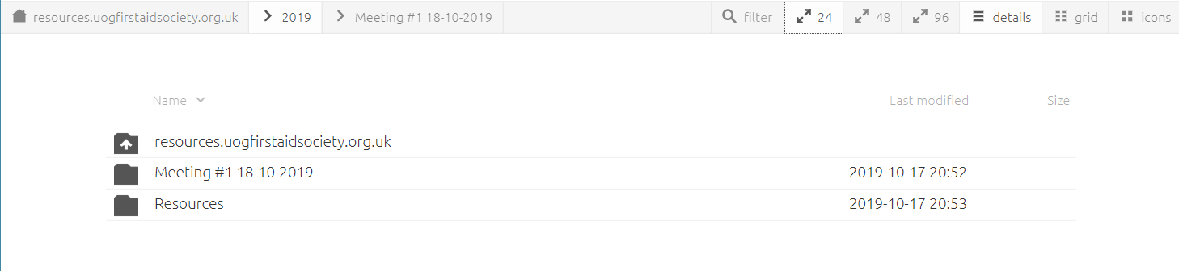

Slide 23
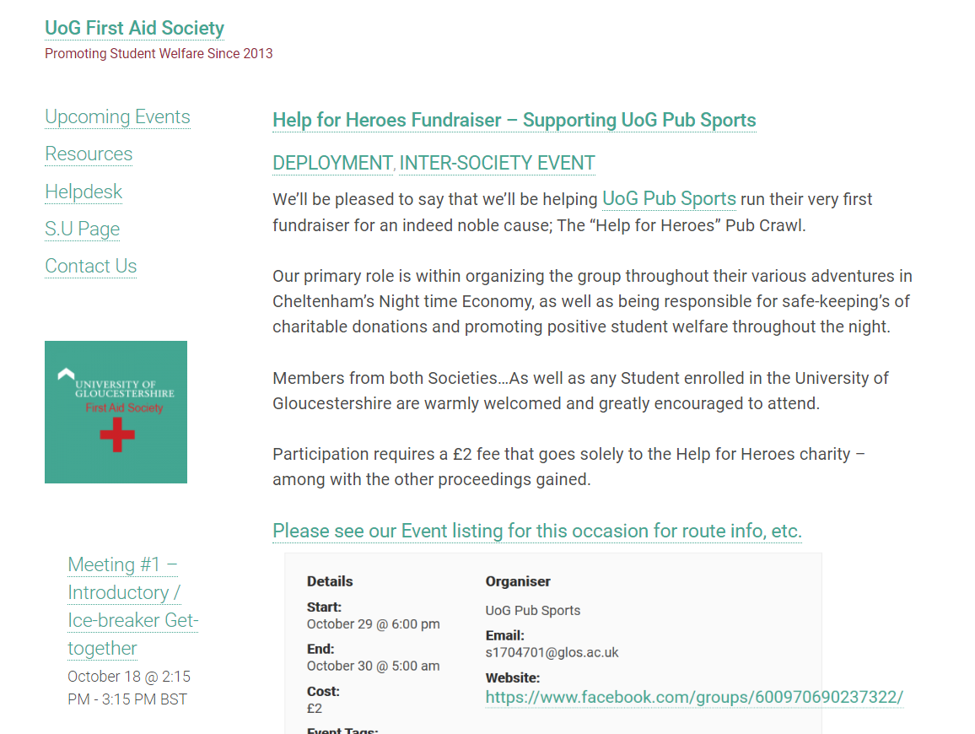
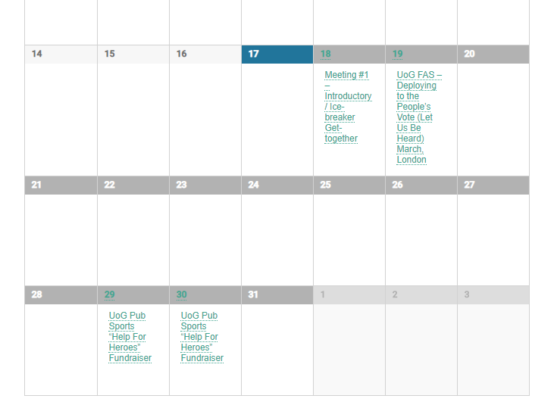
Our Technologies – Our Website
https://uogfirstaidsociety.org.uk
Bridging the gap between the general public and the Society!

Slide 24
Our Technologies - GPS
https://www.strava.com/activities/2630938167

Slide 25
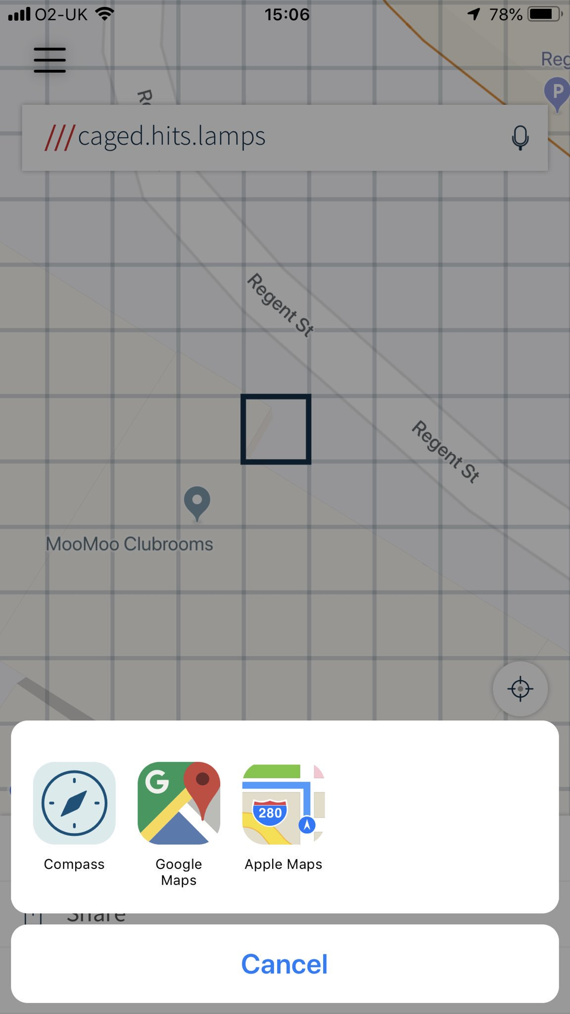
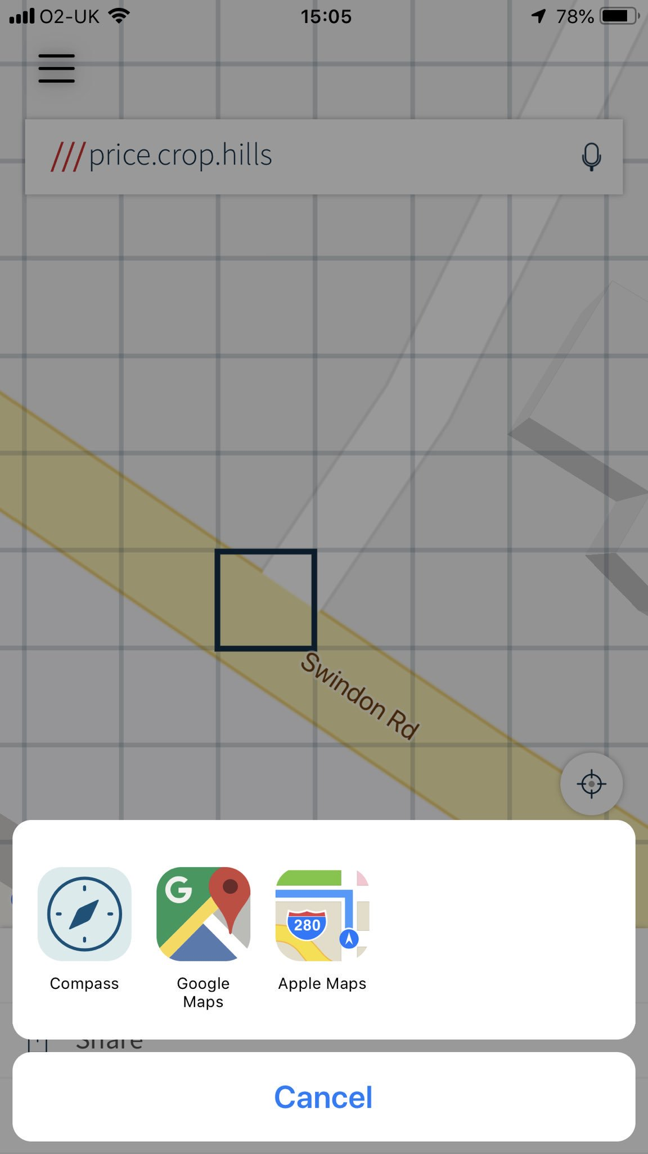

What3Words
https://what3words.com/

Slide 26
Finishing Up - Part. 1
It’s going to be a very interesting and fun Year. Not to say it’s all “up in the air” but the direction the Society takes may deviate from our prospective roadmap.
Non-Member?
Have we represented ourselves as a community you’d like to be apart of?
Are there any questions we haven’t answered that are prohibiting you from joining?

Slide 27
Finishing Up - Part 2
Prospective/Current Member?
Have you purchased a membership from our S.U Page?
If so, join our community Facebook page!
Are there any specific First-Aid related topics you’d like to learn/discuss about?
Let us know!

Slide 28
Upcoming Deployments
Saturday 19th October
“People’s Vote March” Westminster, London 08:00 – 20:00
https://uogfirstaidsociety.org.uk/event/deploying-to-the-peoples-march-in-london-let-us-be-heard-march/
Tuesday 29th October
UoG Pub Sports “Help For Heroes” Fundraiser Pub-Crawl
https://uogfirstaidsociety.org.uk/event/supporting-uog-pub-sports-help-for-heroes/

Slide 29
Social Media / Contact Us
Website
https://uogfirstaidsociety.org.uk
S.U. Society Page
https://www.yourstudentsunion.com/organisation/firstaid/
Facebook Community Group
https://www.facebook.com/groups/uogfas
Twitter
@UoG_FirstAidSoc
E-Mail
uogfirstaidsoc@glos.ac.uk

Slide 30
This Presentation is available for download:
https://resources.uogfirstaidsociety.org.uk/2019/Meeting%20%231%2018-10-2019/
(or check the Facebook group!)

Slide 31
Questions & Feedback

